Slide 1
ELECTRICITY BILLING SYSTEM
RNS INSTITUTE OF TECHNOLOGY
BENGALURU - 98
DEPARTMENT OF INFORMATION SCIENCE & ENGINEERING
Presentation on DBMS Mini Project Work
Sidharth S Pai Surabhi S
1RN20IS160 1RN20IS168
Date:
Time:
Guide
Dr. Prakasha S
Asst. Prof, Dept of ISE, RNSIT
Lab in Charge
Dr. R Rajkumar
Associate Professor, Dept. of ISE, RNSIT

Slide 2
AGENDA
Abstract
Introduction
Front end and Back end tools
ER-Diagram
ER to Schema Mapping
Schema Diagram
Tables description with Normalization
Stored Procedures and Triggers
Results
Snapshots
Applications
Conclusion
References

Slide 3
ABSTRACT
Electricity consumers are often faced with the problem of inaccuracy and delay in monthly billing due to some drawbacks. Thus, it is essential to have an efficient system for such purposes via electronic platform with consideration to proximity.
The proposed system automates the conventional process of paying electricity bill by visiting the Electricity Board which is tiresome and time consuming. It is also designed to automate the electricity bill calculation and payment for user convenience.
The system then calculates the electricity bill for every user and updates the information into their account every month. Users can then view their electricity bill and pay before the month end.

Slide 4
INTRODUCTION
Electricity Billing System is a software-based application.
This project aims at serving the department of electricity by computerizing the billing system.
It mainly focuses on the calculation of units consumed during the specified time and the money to be charged by the electricity offices.
This computerized system will make the overall billing system easy, accessible, comfortable, and effective for consumers.
To design the billing system more service oriented and simple, the following features have been implemented in the project. The application has high speed of performance with accuracy and efficiency.
The software provides facility of data sharing, it does not require any staff as in the conventional system. Once it is installed on the system only the meter readings are to be given by the admin where customer can view all details, it has the provision of security restriction.
The electricity billing software calculates the units consumed by the customer and makes bills, it requires small storage for installation and functioning.

Slide 5
LITERATURE SURVEY
Traditional File System
The traditional approach to data handling offered a lot of the convenience of the manual approach to business processes (ex. handwritten invoices & account statements, etc.) .
Initially, these separate systems were very simple to set up as they mostly mirrored the business process that departments had been doing for years but allowed them to do things faster with less work. However, once the systems were in use for so long, they became very difficult for individual departments to manage and rely on their data because there was no reliable system in place to enforce data standards or management.
Pros:
Simple
Initially low cost
Cons:
Unmanaged redundancy
Lack of data sharing and higher costs in the long run.

Slide 6
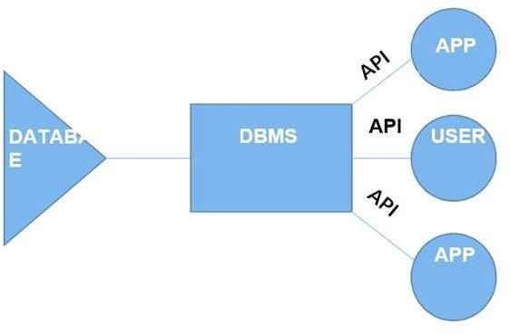
Contd.
Database Management System
A database management system (DBMS) refers to the technology for creating and managing databases. Basically, a DBMS is a software tool to organize (create, retrieve, update and manage) data in a database.
The main aim of a DBMS is to supply a way to store and retrieve database information that is both convenient and efficient.
Advantages of a DBMS
Data independence
Efficient data access
Data security
Components of a DBMS
Users and DBMS
Database and database applications

Slide 7
Requirements
Hardware Requirements:
Hardware Specification: -Processor Intel Pentium V or higher
Clock Speed: -1.7 GHz or more
System Bus: -64 bits
RAM: -16GB
Software Requirements:
Operating System: -Windows 11
Software: -Microsoft SQL Server
Front End: -Java core/swings (Eclipse)
Back End: -My SQL

Slide 8
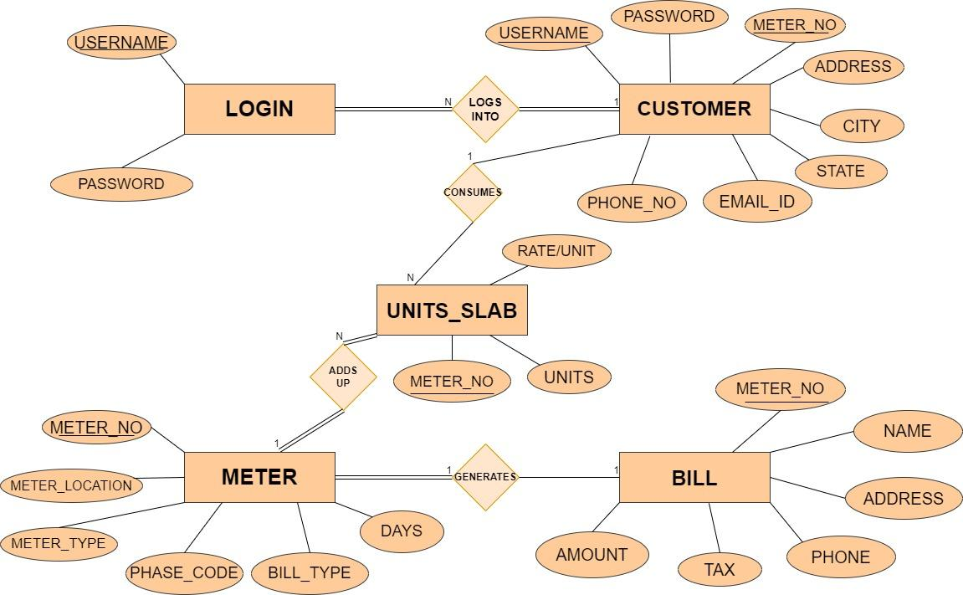
ENTITY-RELATIONSHIP DIAGRAM

Slide 9
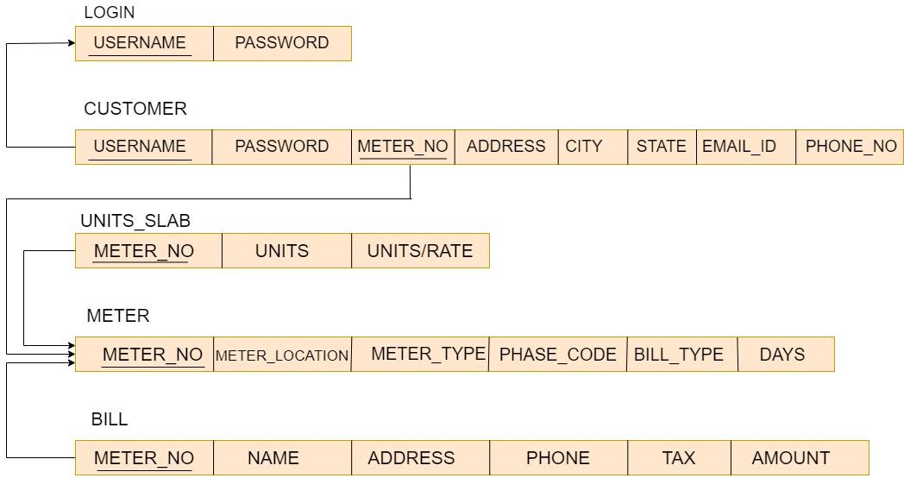
SCHEMA DIAGRAM

Slide 10
Implementation / Coding
Explanation of Algorithm or pseudocode of system:
Start system
Enter login name and password
On clicking the login button
Connect to database
Query database to know whether user credentials are correct
If not, deny access and return login page with an error message
If correct, check if credentials for administrator
If yes, allow login
Set admin session, re-direct administrator to admin login page
If no, allow login set user session
Re-direct user to user home page

Slide 11
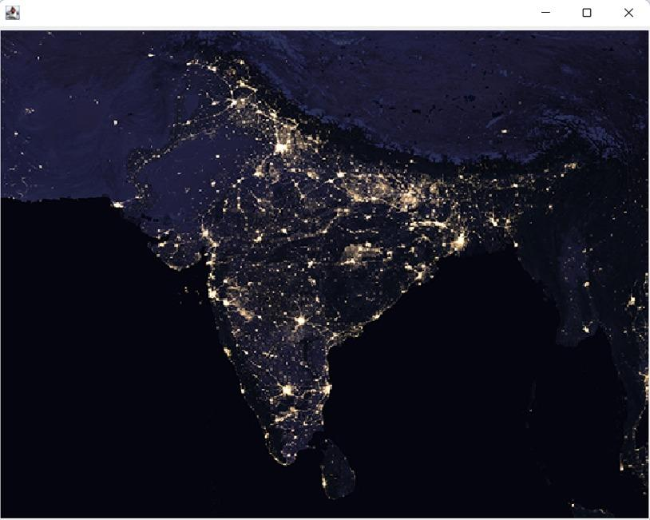
Snapshots
SPLASH SCREEN

Slide 12
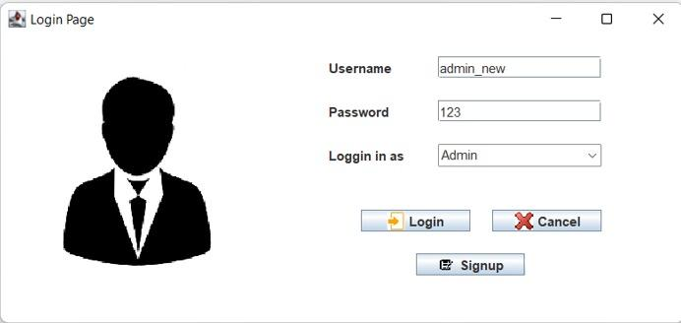
Login Page

Slide 13
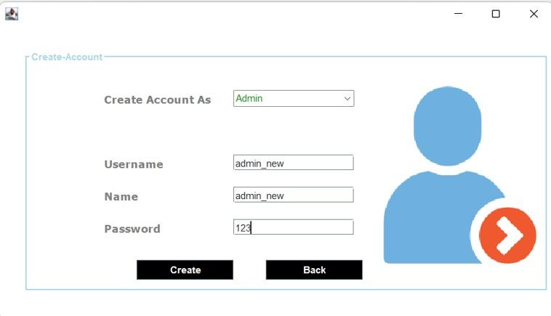
Account Creation

Slide 14
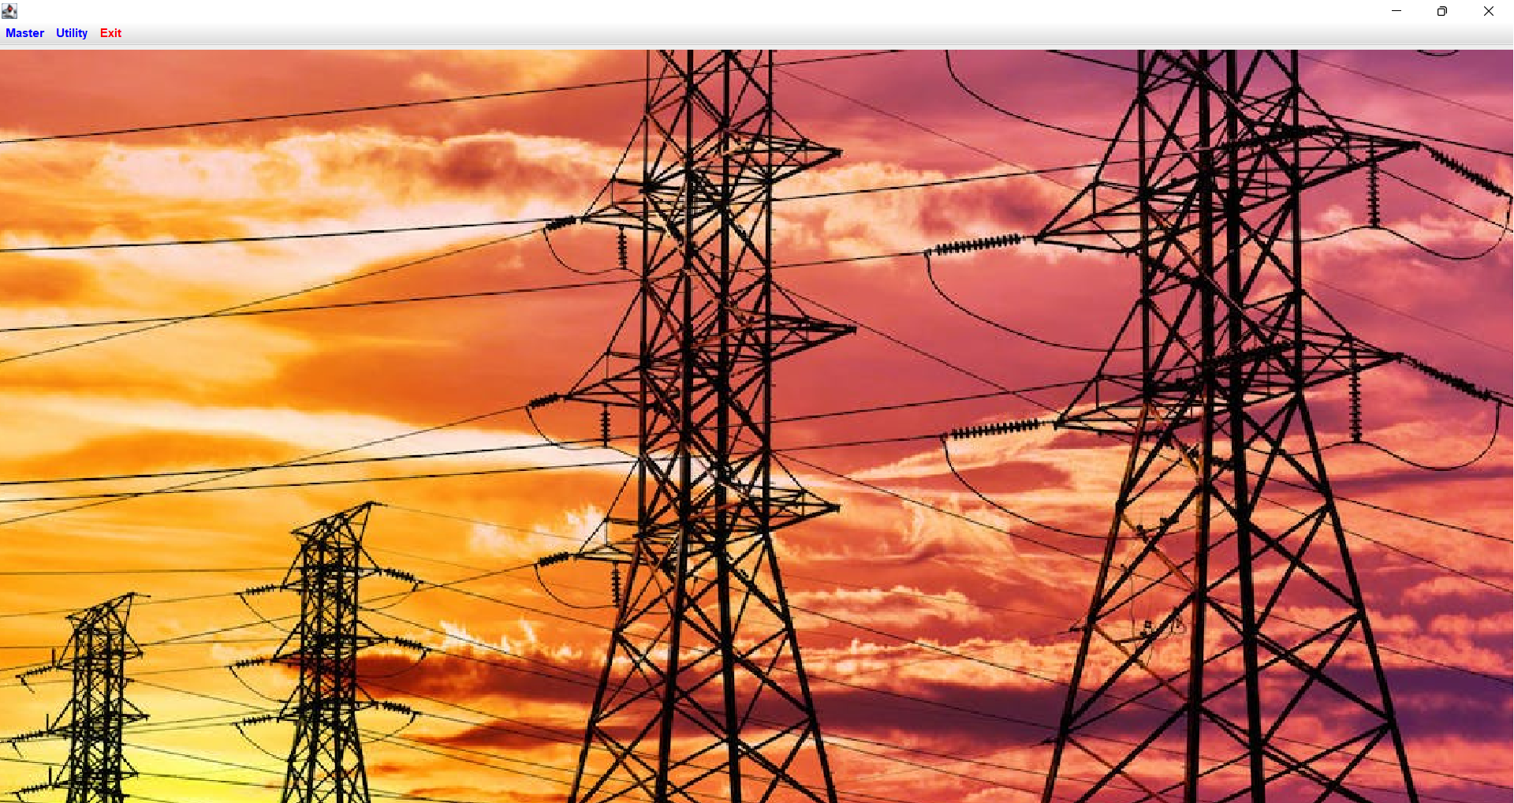
Admin Homepage

Slide 15
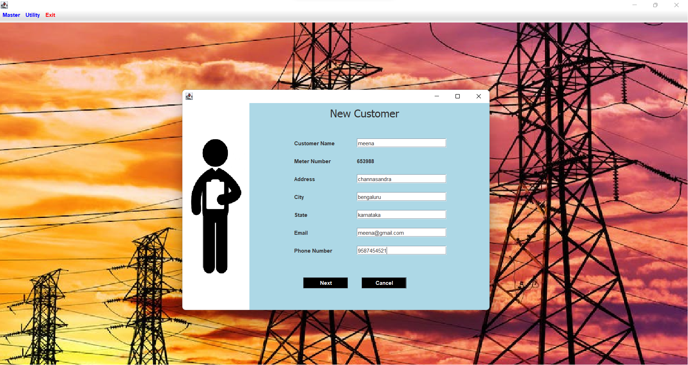
New Customer Insertion : Admin Access

Slide 16
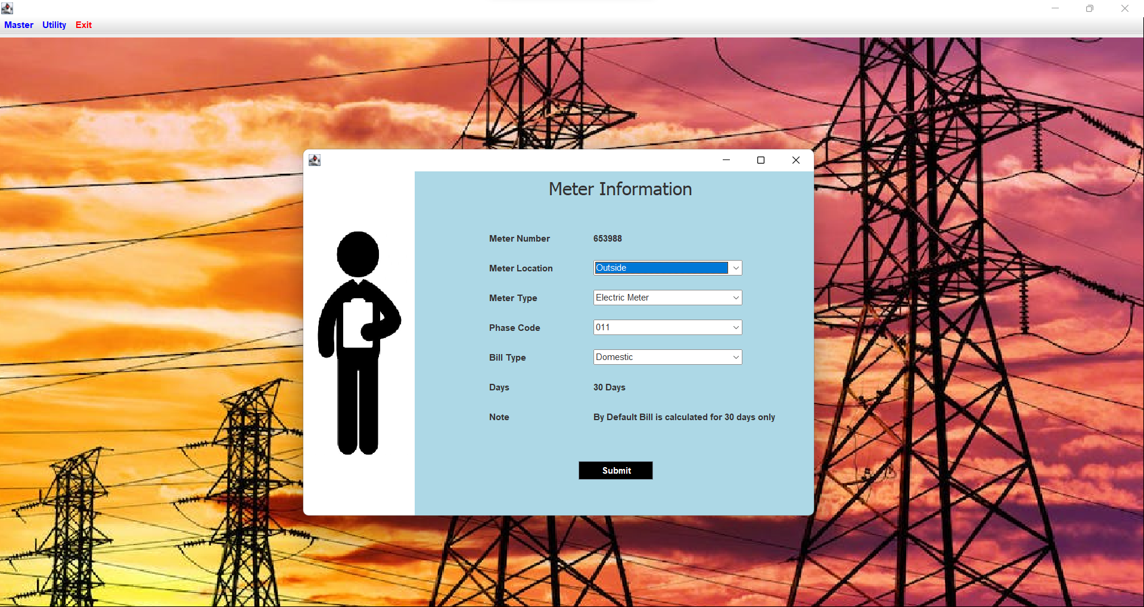
Meter Information: Admin Access

Slide 17
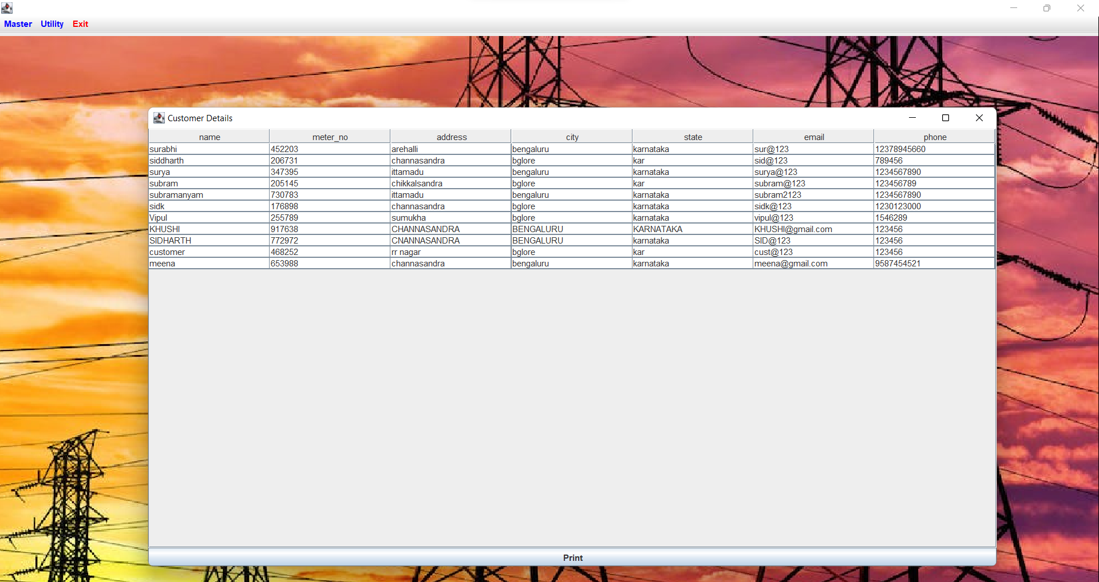
Customer Details

Slide 18
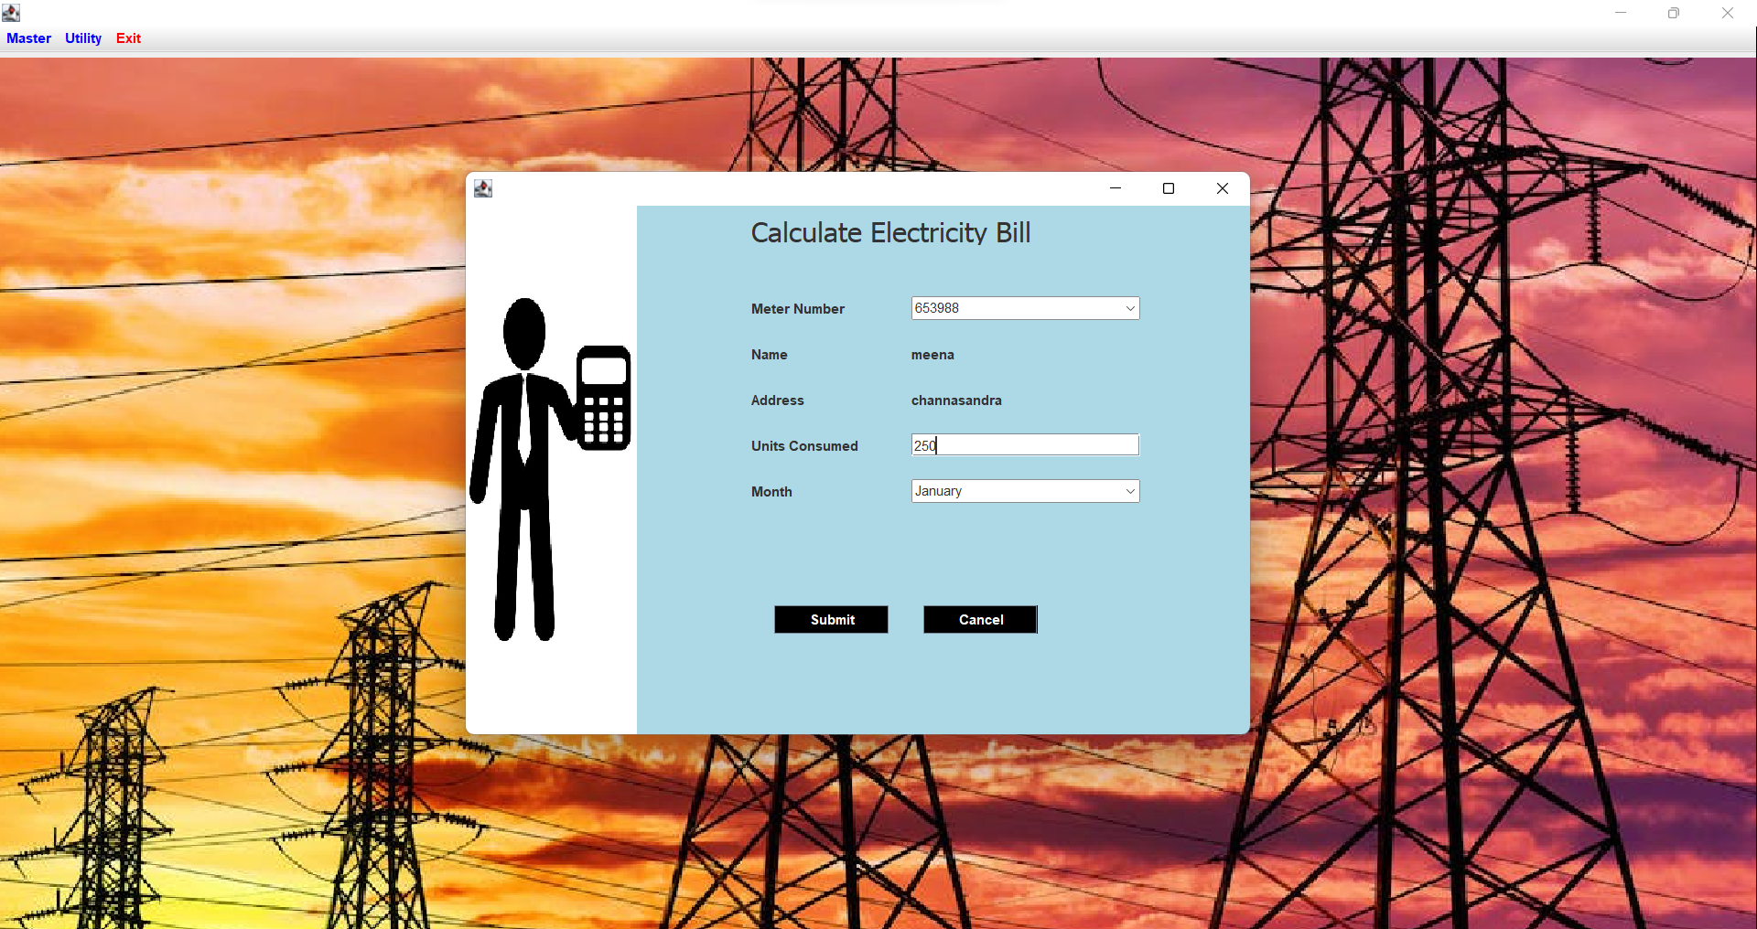
Electricity Bill Calculation : Admin Access

Slide 19
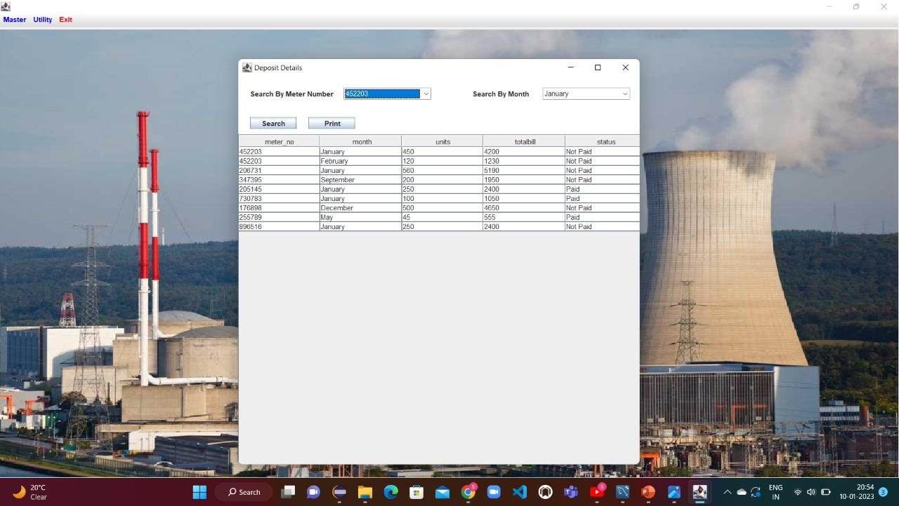
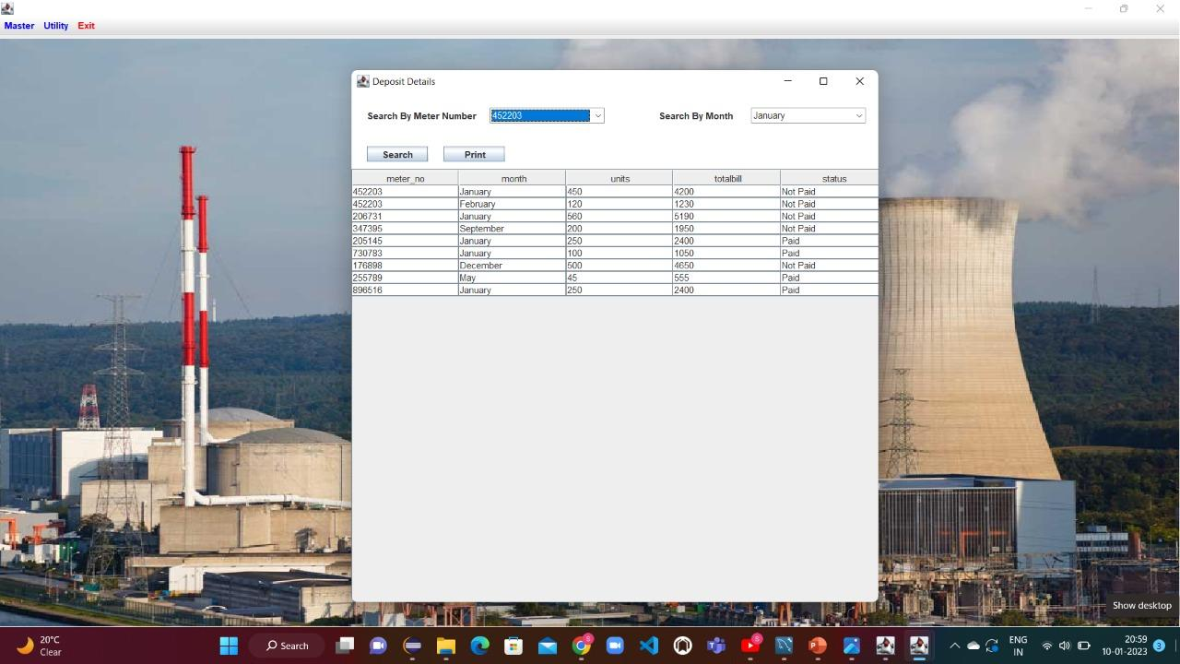
Deposit Details

Slide 20

Customer Homepage

Slide 21
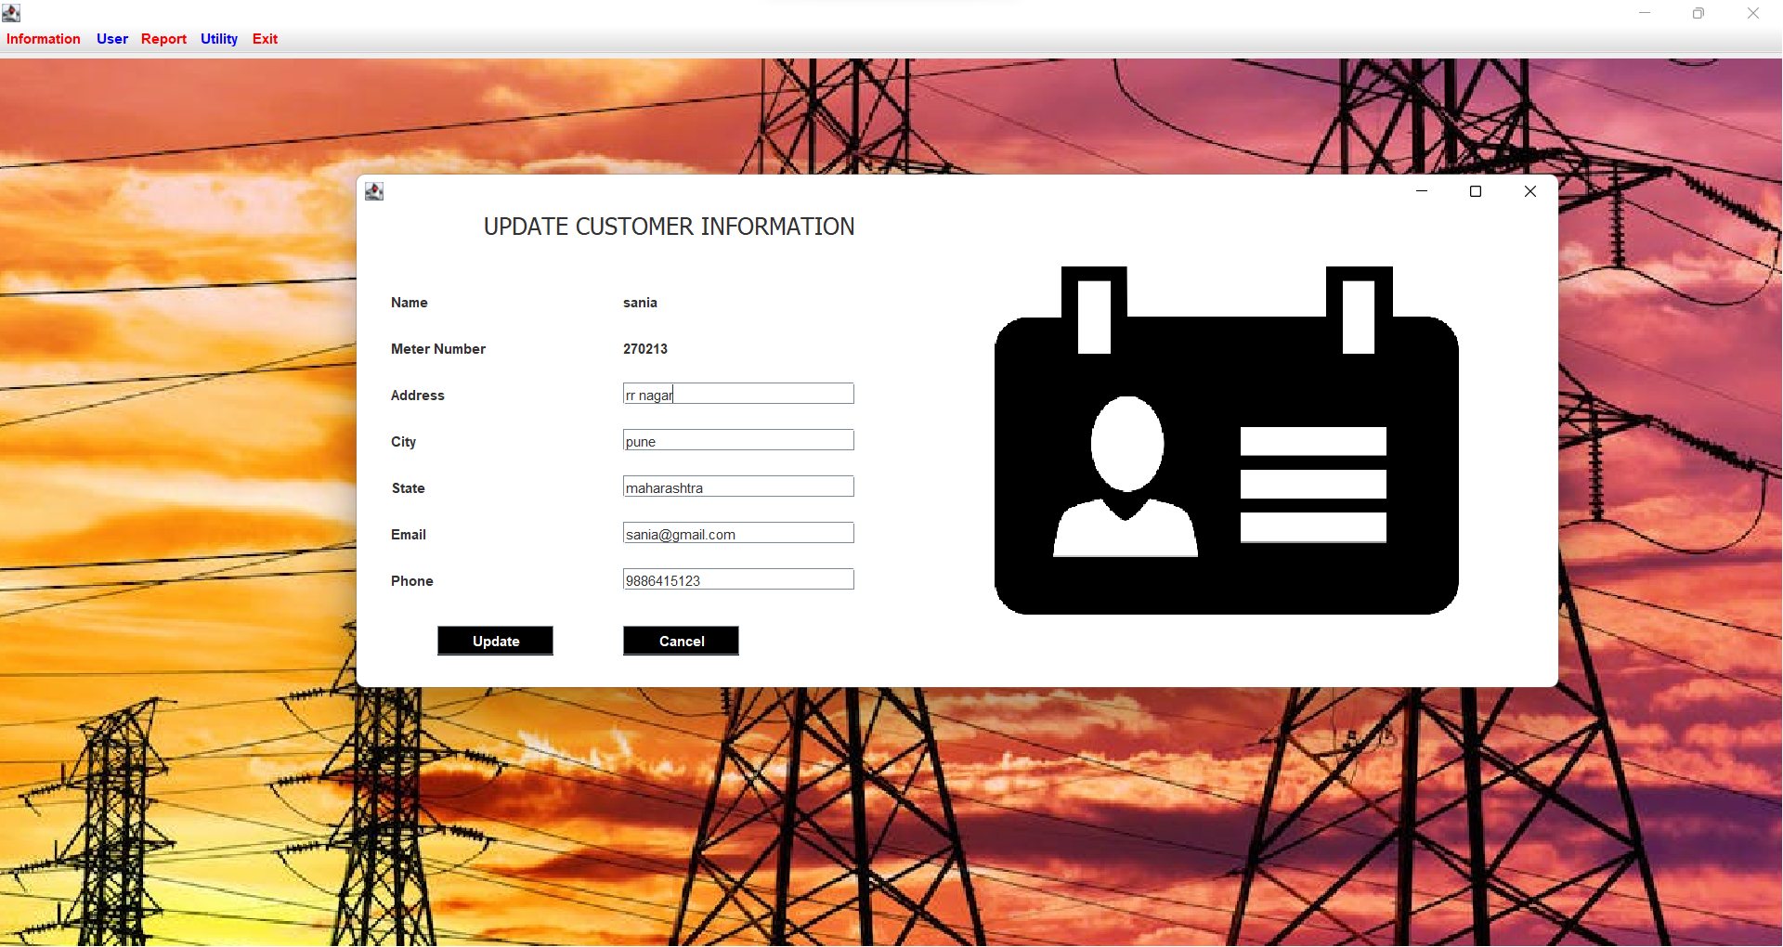
Update Customer Information : Customer Access

Slide 22
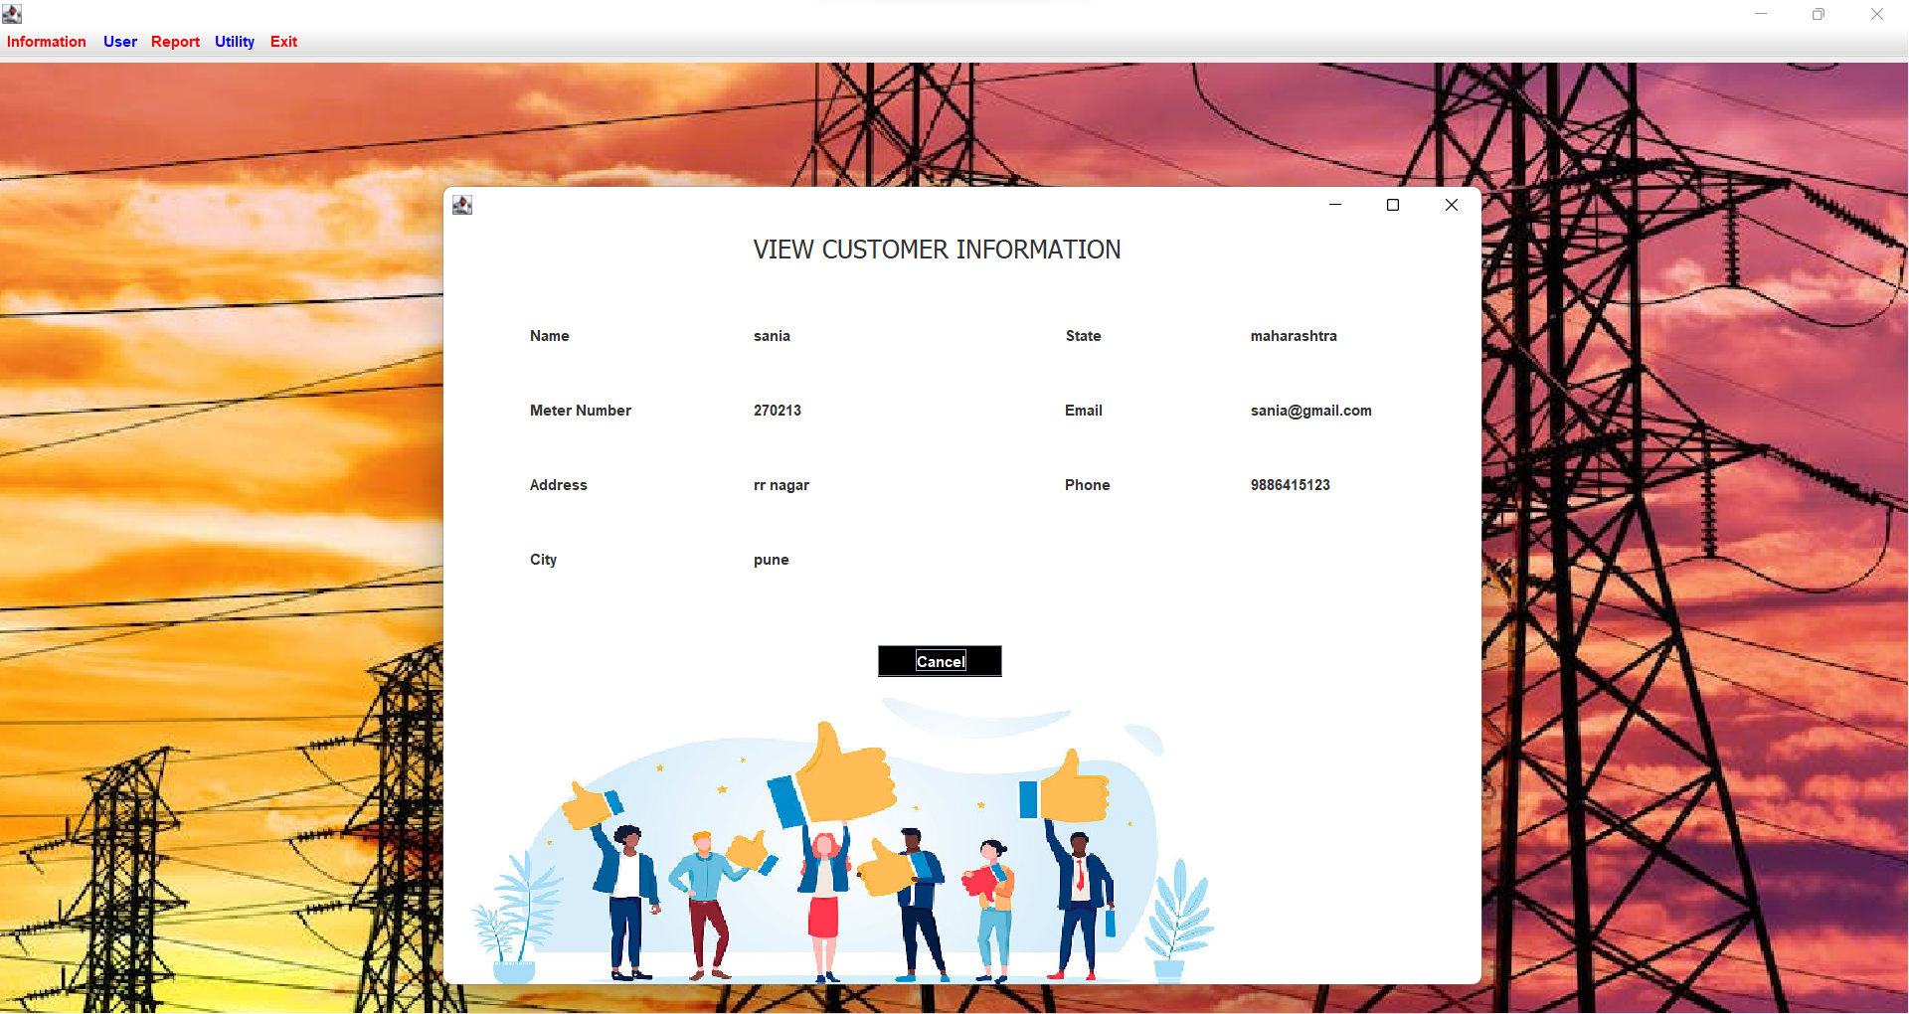
View Customer Information

Slide 23
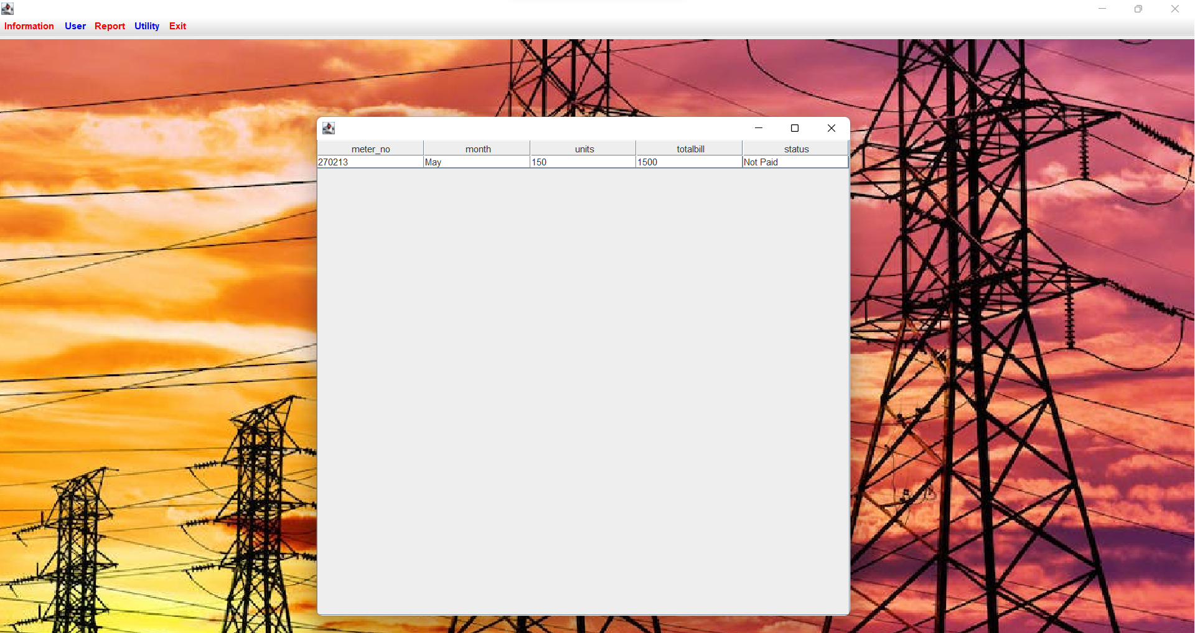
Bill Payment Status

Slide 24
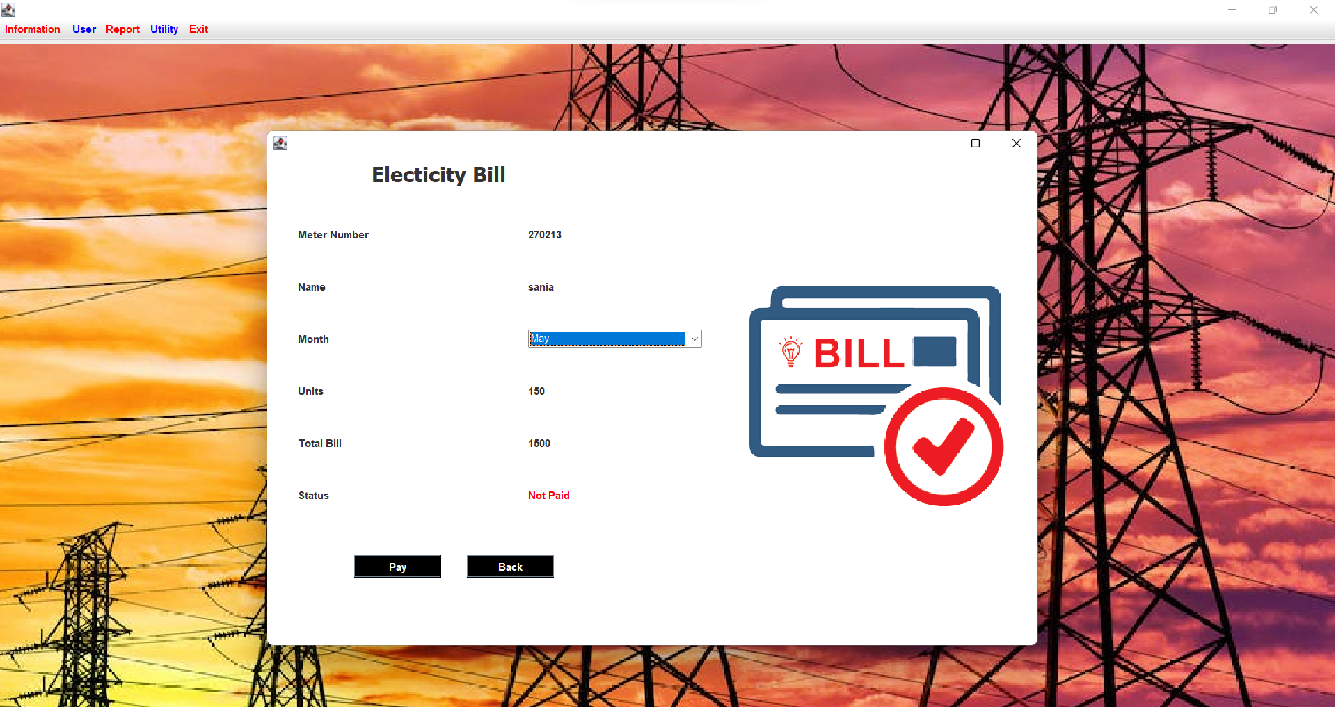
Bill Payment Status Contd. (Unpaid)

Slide 25
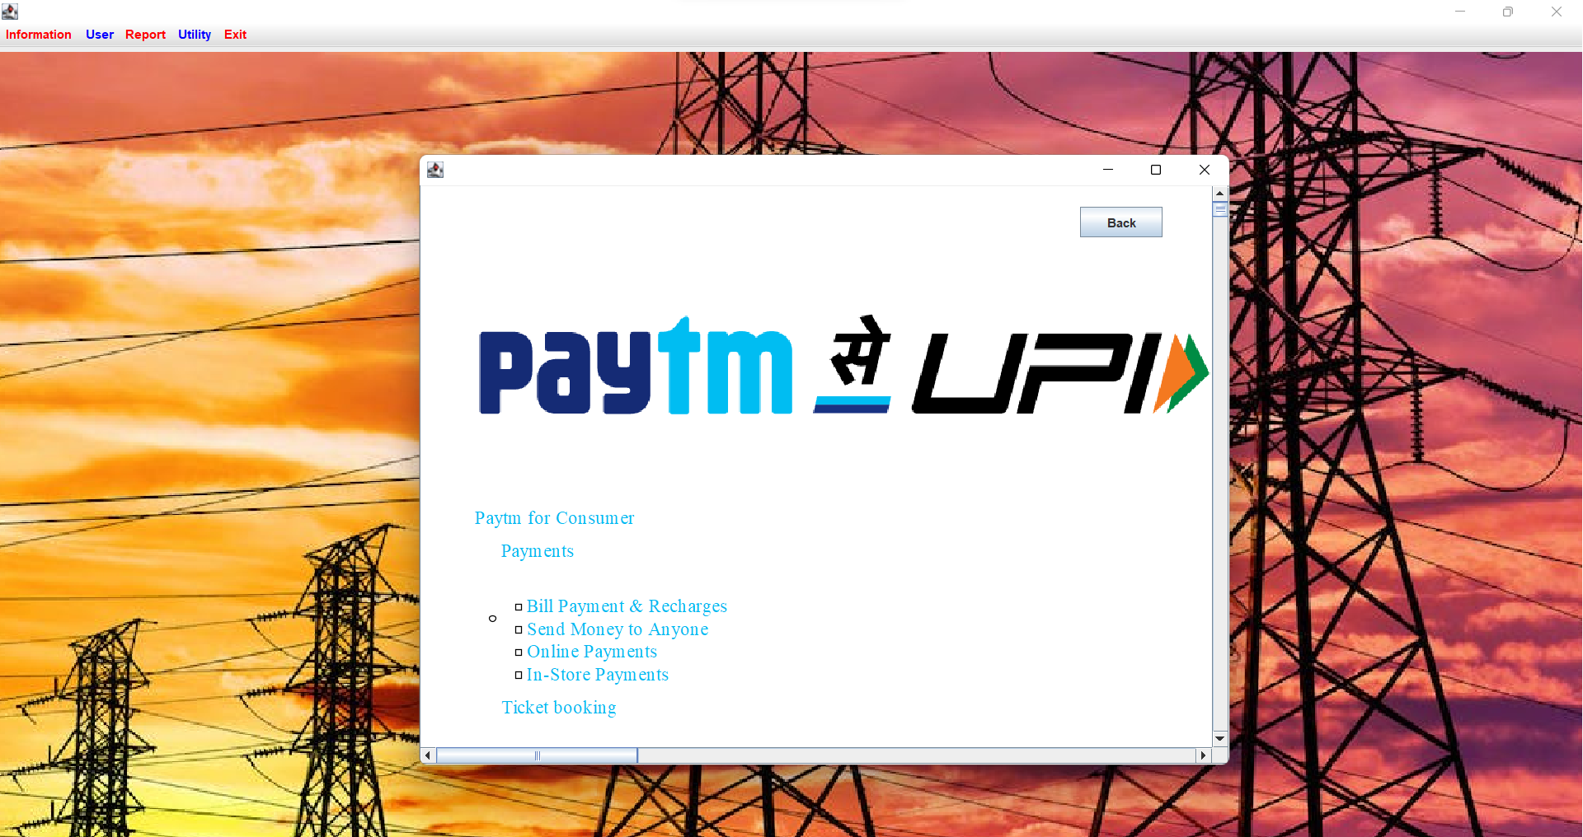

Slide 26

Bill Payment Status Contd. (Paid)

Slide 27
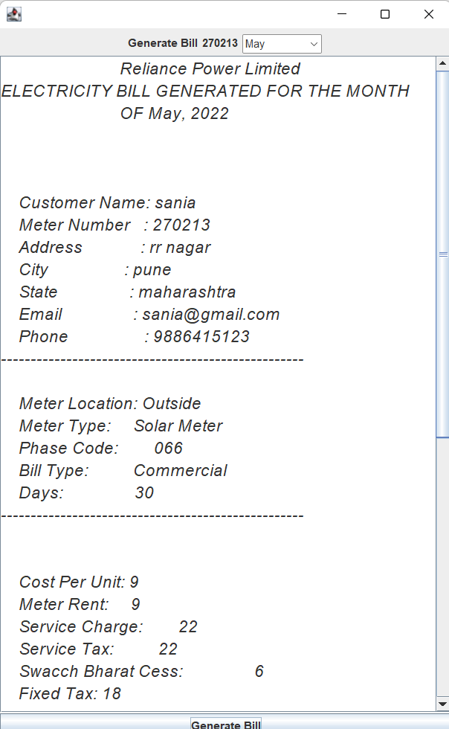
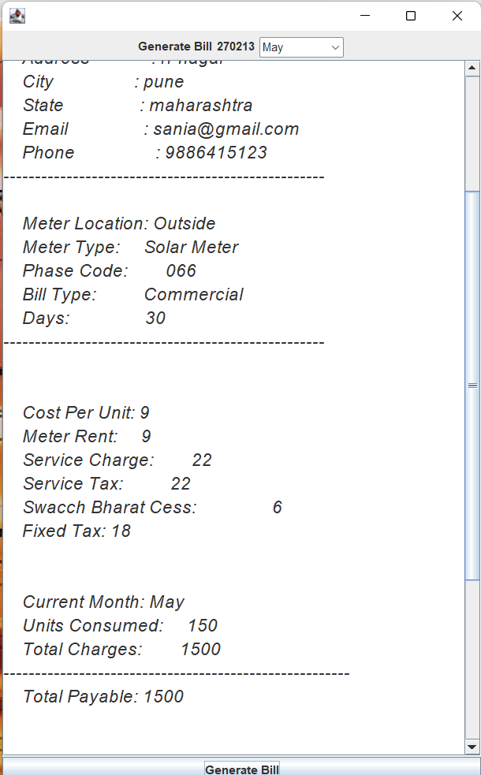
Bill Generated Display

Slide 28
Testing
Steps | Action | Expected output
Step1 choice | The screen appears when the users run the program. 1.If admin login 2.If customer login | A page with different menu’s appears. 1.Admin panel opens and 2.Customer panel opens
Step 2 | The screen appears when the admin logs in and selects any one of the menus from the click of the mouse. | A window for adding new customer, inserting tax, calculate bill, view deposit details etc
Selection 1 | New Customer Customer Details Deposit Details Calculate Bill Meter Info

Slide 29
CONCLUSIONS
After all the hard work is done for electricity bill management system is here. It is a software which helps the user to work with the billing cycles, paying bills, managing different DETAILS under which are working etc.
This software reduces the amount of manual data entry and gives greater efficiency. The User Interface of it is very friendly and can be easily used by anyone. It also decreases the amount of time taken to write details and other modules.

Slide 30
FUTURE ENHANCEMENTS
Hosting the website on an online web server.
Payment verification through an authorized client can also be implemented.

Slide 31
References
Raghu Ramakrishnan and Johannes Gehrke, Database Management Systems, McGRAW HILL, 3rd Edition.
Ramez Elmasri and Shamkant B. Navathe, Fundamentals of Database Systems, Pearson, 7th Edition.
www.stackoverflow.com
www.mysql.com/doc
https://docs.microsoft.com
https://www.geeksforgeeks.org
https://www.youtube.com

Slide 32
Question and Answer

Slide 33
THANK YOU

